Slide 1

PICKDO
PITCH DECK

Slide 2
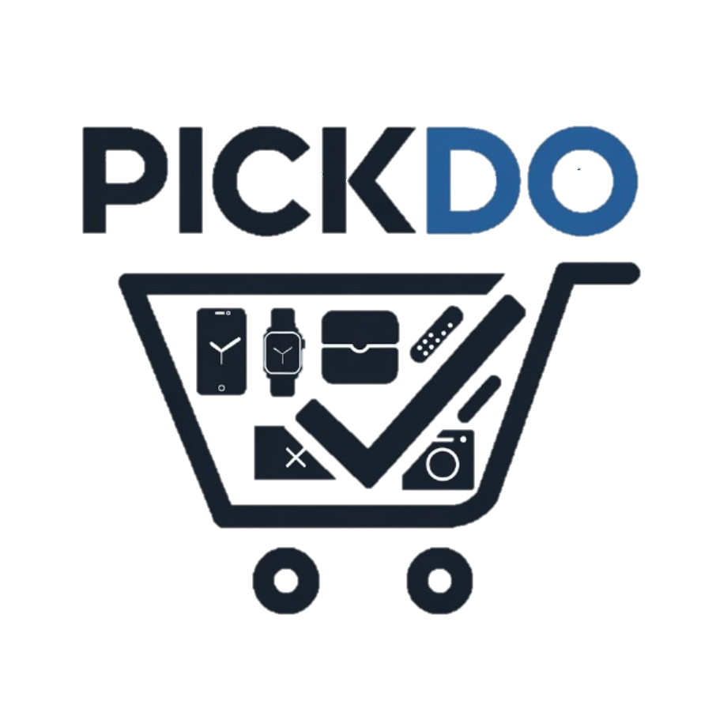

Who we are
Name of your Venture: PICKDO
Why ?
Thought behind this Business Idea
In today’s vast e-commerce landscape, users often face choice overload. We aim to simplify decision-making by delivering tailored recommendations that align with user preferences, ensuring they find the right products without endless browsing. We provide the top 5 products based on user preferences while generating affiliate revenue.
What ?
What does the Venture Do?
PickDo is a personalized recommendation platform that streamlines the shopping experience by providing users with customized product suggestions. Based on user preferences—such as price range, features, and categories - PickDo curates a list of top products, helping users make informed decisions quickly and conveniently.
How ?
How we Solve the Problem & Revenue generation
"Our AI-powered system filters products according to user preferences, delivering personalized recommendations with direct purchase links.. We generate revenue through affiliate marketing, earning commissions from purchases made via our recommendation links on partnered e-commerce platforms."

Slide 3
Problem/Opportunity
CONTEXT In the rapidly growing e-commerce market, users face an overwhelming number of product choices across platforms. This “choice overload” can make the shopping experience time-consuming and stressful. Busy, tech-savvy consumers, especially, are seeking solutions that allow them to quickly find quality products that match their preferences without extensive browsing. | PROBLEM Users lack an efficient and personalized way to sift through countless product options. Without curated, relevant recommendations, they spend excessive time navigating product lists, comparing items across different sites, and struggling to make quick and informed decisions. This issue is especially pronounced when specific user needs (like budget, features, and quality) are not adequately addressed by existing platforms. | ALTERNATIVES Current Alternatives: Many users currently rely on basic e-commerce search filters, reviews, or third-party review websites to make decisions. However, these solutions lack personalization and can still be time-consuming and overwhelming. Limitations of Alternatives: These options often fail to meet the need for quick, tailored recommendations, leaving users unsatisfied and still prone to decision fatigue.
Customers Who Experience the Problem Most Often: Target Customer Profile: Busy, tech-savvy individuals, typically between 20–35 years old, who value efficiency and trust in their shopping experience. Frequency of Problem: These customers, often with full-time jobs and active social lives, frequently shop online but are easily frustrated by long browsing times. They typically look for quality products in categories like electronics, lifestyle, and everyday essentials. | EMOTIONAL IMPACT How does the customer feel? Before using our platform: Anxious doubtful After using our platform: The overwhelming choice leads to frustration, stress, and dissatisfaction. | ALTERNATIVE SHORTCOMINGS Disadvantages of Current Alternatives: Lack of Personalization: Comparison sites and generic reviews don't tailor recommendations to individual user needs or preferences. Time-Consuming Process: Users spend significant time manually researching and comparing products across multiple sites. Outdated Information: Many reviews or comparisons lack updates on the latest products or current promotions. Limited Trustworthiness: Users often question the authenticity of generic reviews, suspecting bias or hidden sponsorships.
 | QUANTIFIABLE IMPACT Time savings: On average, customers will reduce their research and comparison time by 50% by using our platform instead of traditional research methods. Revenue growth: Projected monthly growth rate of 10-15% from affiliate partnerships and user engagement.

Slide 4
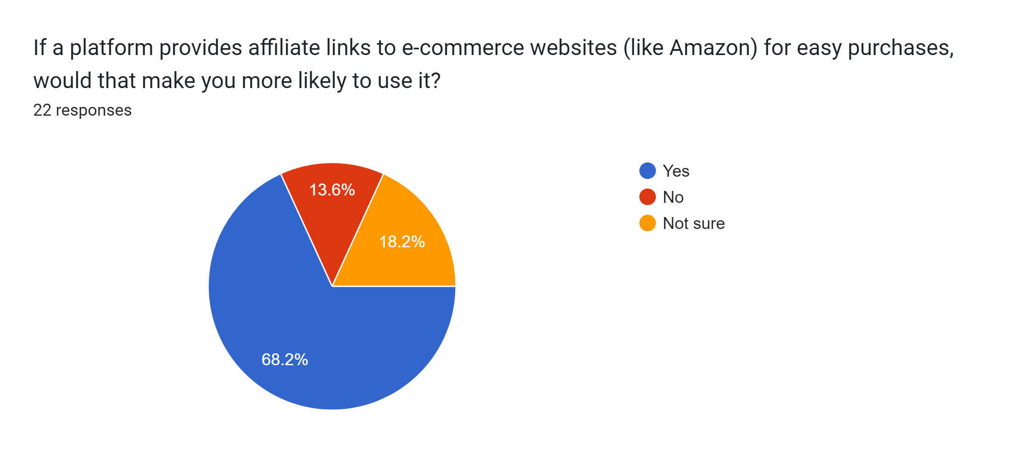
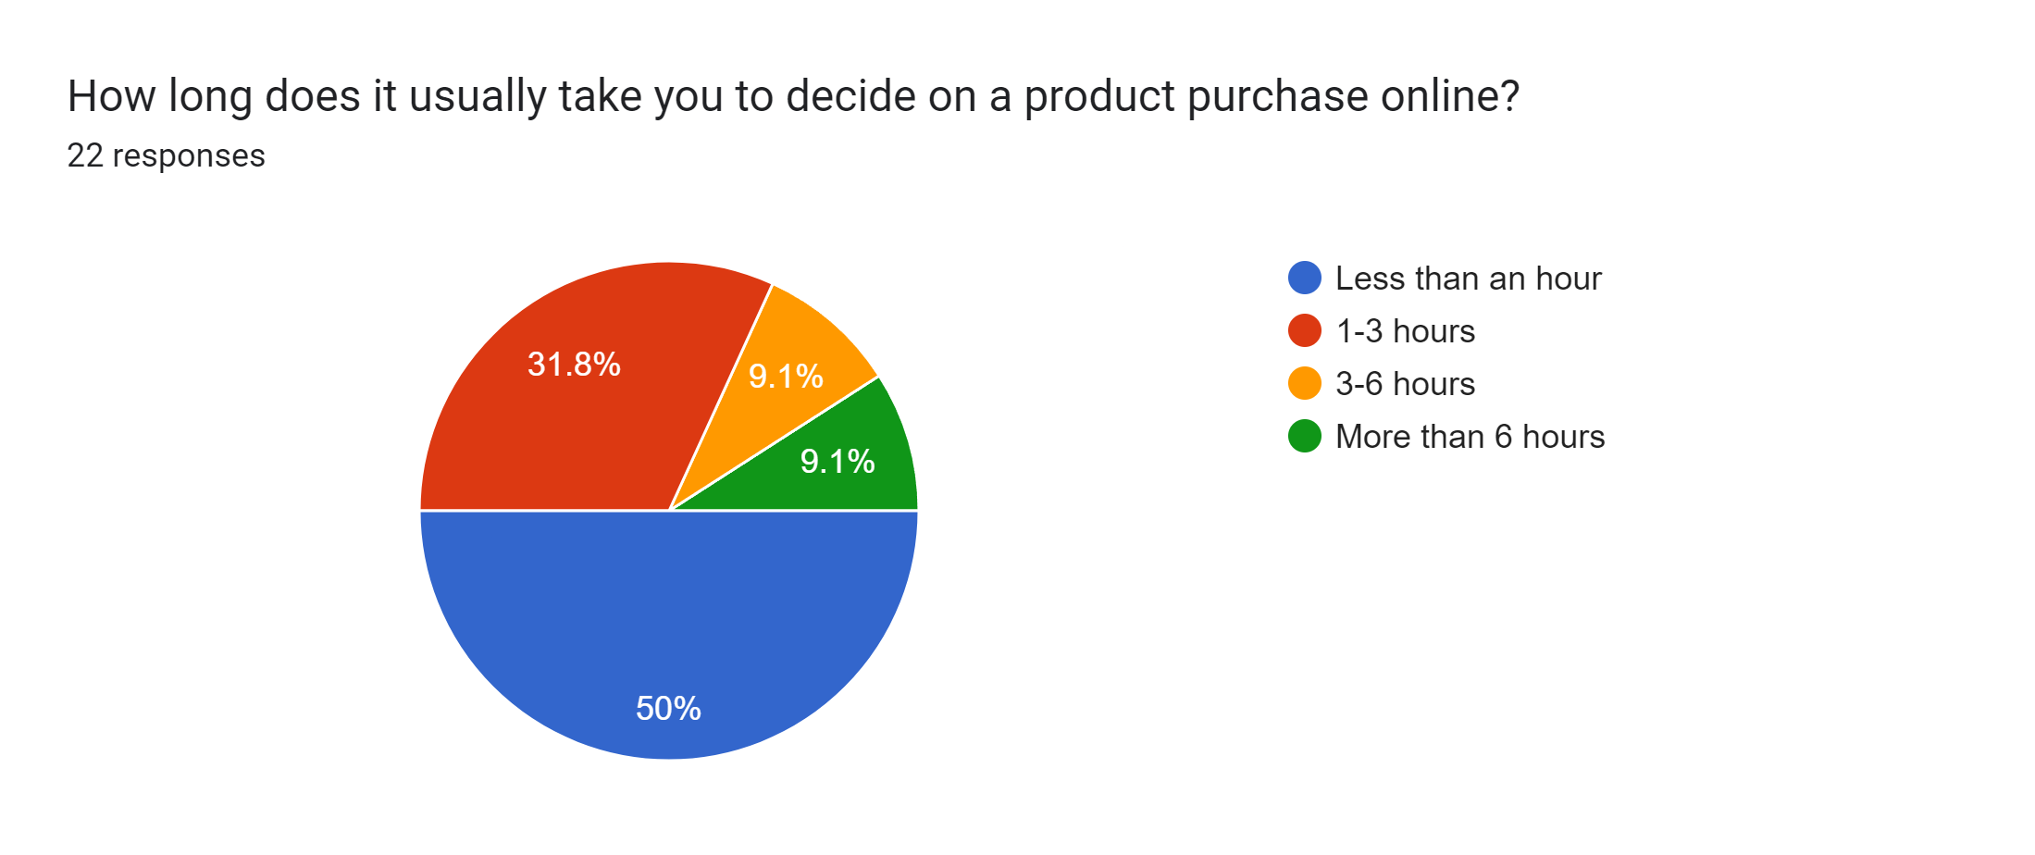
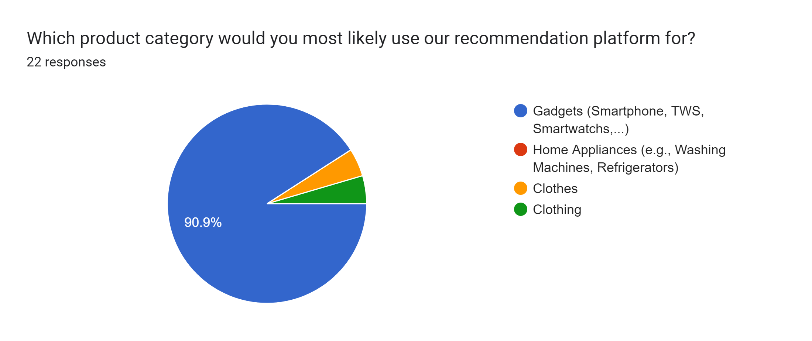
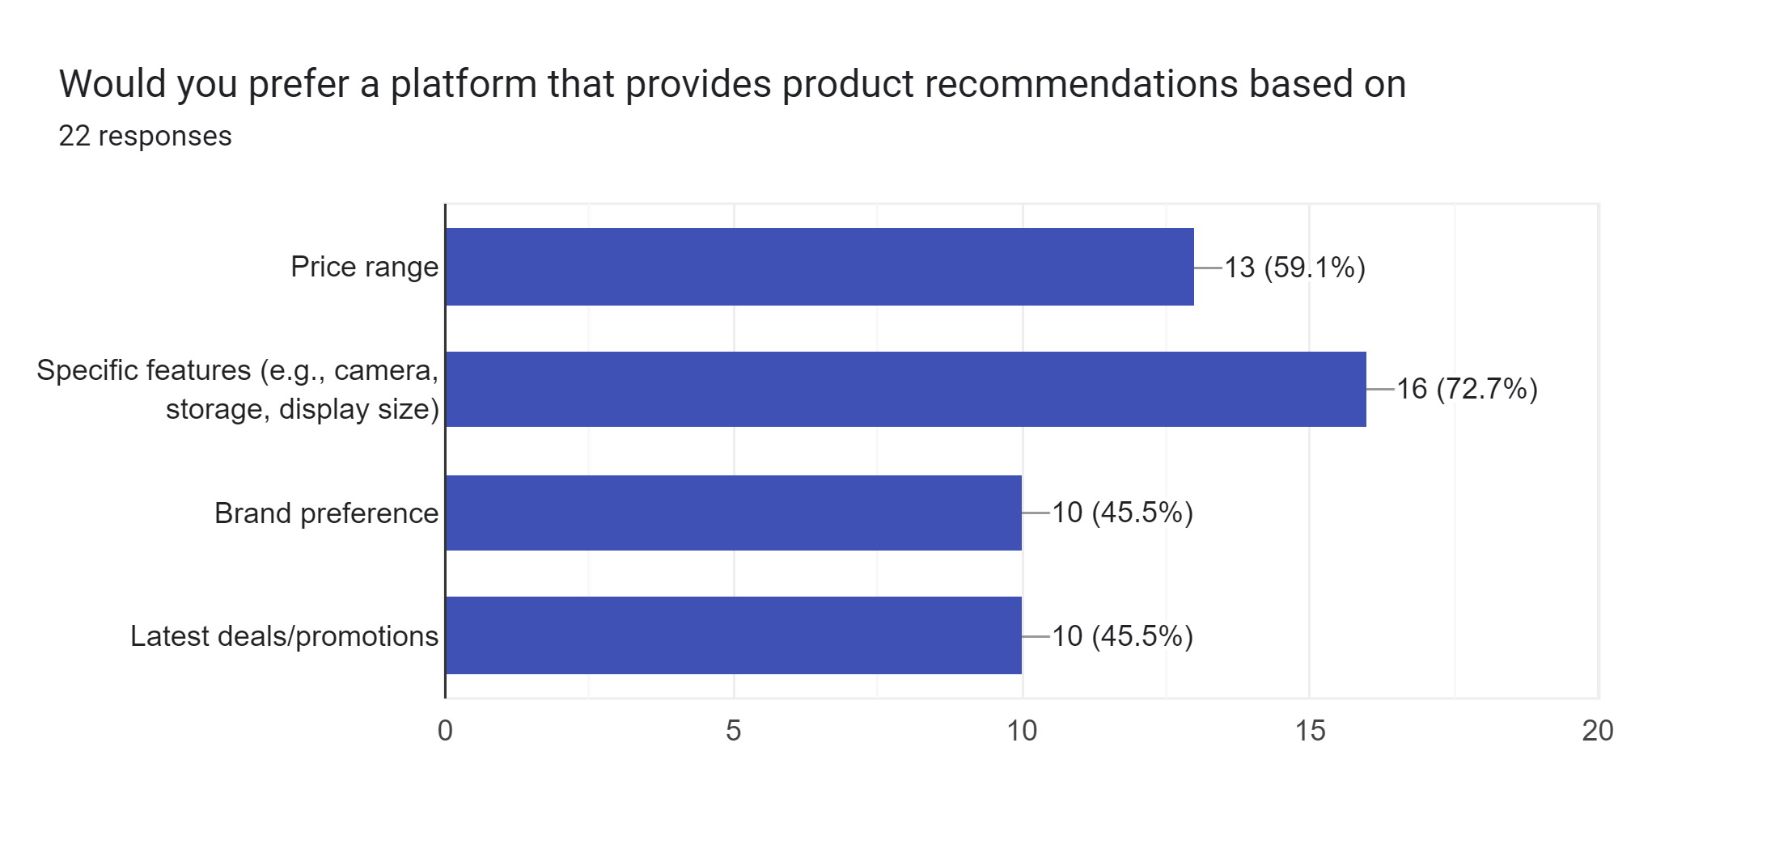
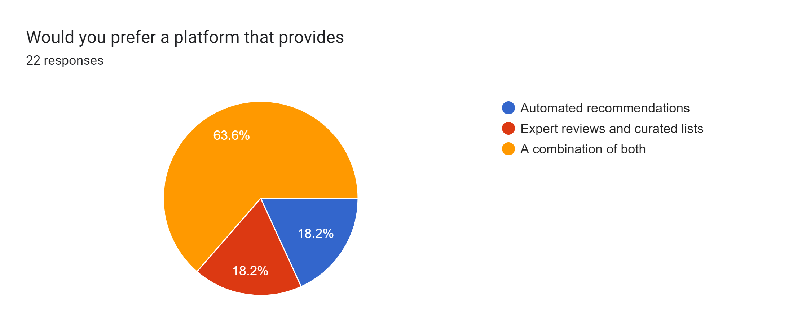
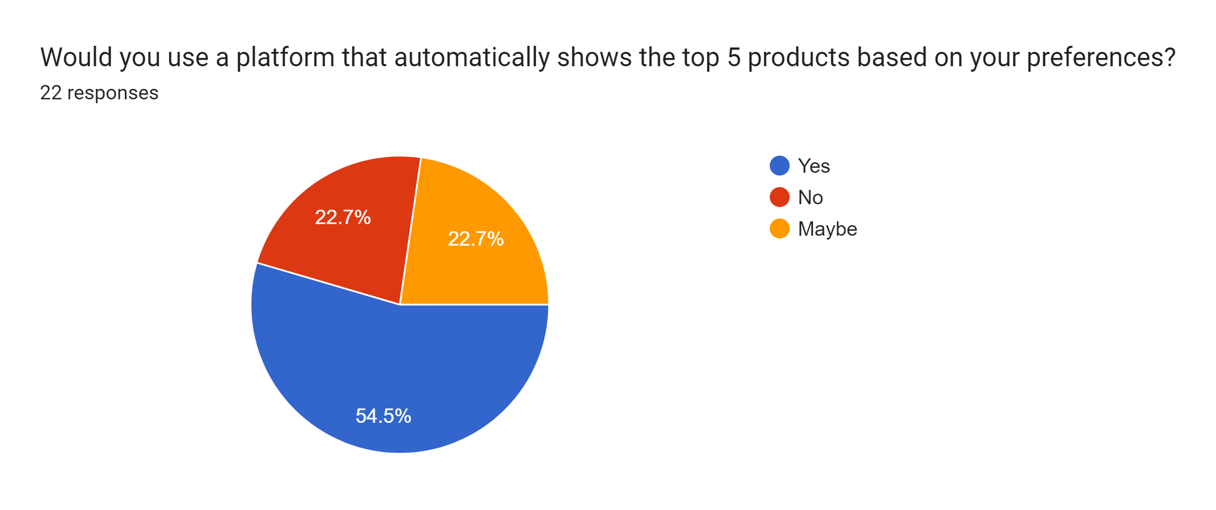
Problem Interviews And Surveys Results
We interviewed 22 customers through online mode.
Out of them, 16 identified the problem as significant.
These customers expressed a strong interest in the solution we propose.
Survey analysis

Slide 5
Market Size Estimation
How to calculate market size?
1. Start with Total Addressable market(TAM) - $70 billion(overall e-commerce market in India).
TAM refers to the total market demand for a product or service.
The TAM for PickDo is estimated at $70 billion, which encompasses the entire e-commerce market in India. This figure provides a broad understanding of the potential market demand, highlighting the extensive reach of e-commerce and the opportunities within it.
2. Serviceable Addressable Market (SAM)
PickDo’s SAM is approximately $28.2 billion, focusing on the segments within the e-commerce market where personalized product recommendations are especially valued. This SAM reflects PickDo's target audience’s demand, particularly in tech, lifestyle, and popular consumer goods where choice overload is prevalent
3.By conducting research with existing competitors, distributors etc., understand the likely penetration rate 2% .
4. Multiply target market by penetration rate to find your market size(SOM)$564 million.
Niche Market Focus:
To further refine its positioning, PickDo should focus on high-demand niches, such as tech gadgets, consumer electronics, and lifestyle products. By targeting these categories, PickDo can differentiate itself within the broader e-commerce market, addressing the specific needs of customers seeking efficient, trustworthy product guidance in areas of high choice overload
$70 billion
$28.2 billion
$564 million
.
Source link of base statistics:
https://www.statista.com/topics/2454/e-commerce-in-india/#statisticChapter

Slide 6
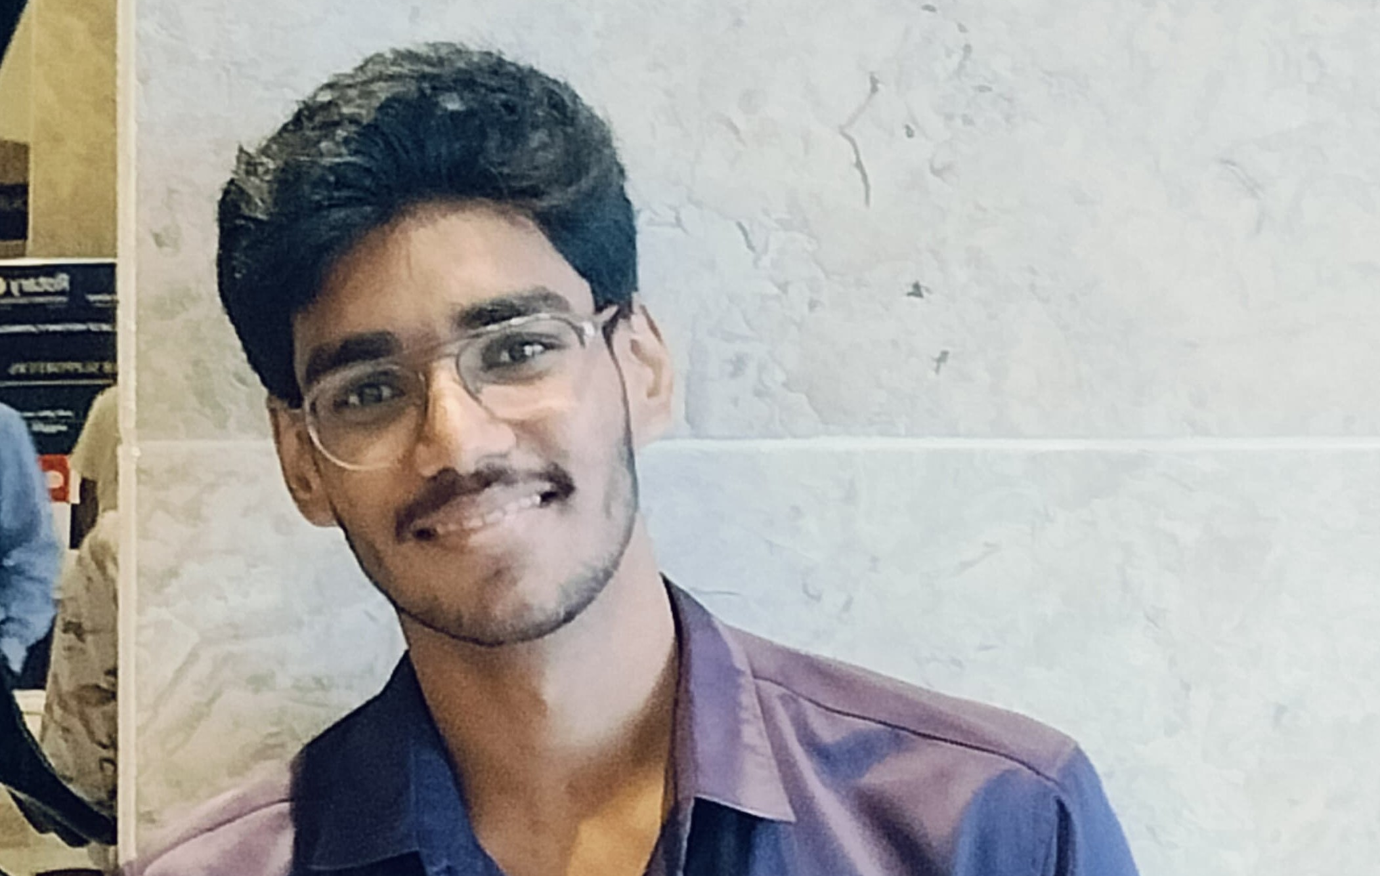
Customer Persona
Tech-Savvy
Efficiency-Seeking
Trust-Seeking
Goals
Quickly discover top products that match specific personal preferences. Minimize time spent on research by accessing tailored, reliable recommendations. Find quality products that offer innovative features to enhance daily life.
Motivations
Frustrations
Overwhelmed by the sheer volume of products and options available online. Finds it challenging to get personalized recommendations that genuinely meet their needs. Dislikes spending excessive time comparing products across different websites
Enhance my shopping journey with tailored, time-saving suggestions, enabling me to concentrate on what is most important in my hectic life.
Age: 24
Occupation: Software Engineer
Location: Hyderabad
Bio
Tech-savvy individual is passionate about staying informed on the latest electronics and innovative technologies. With a busy schedule, they prioritize efficient shopping experiences and value personalized recommendations that streamline decision-making. Frustrated by the time-consuming process of comparing products across various websites, they seek a solution that simplifies finding the best products tailored to their preferences. Driven by a desire for convenience, they are eager to explore curated options that enhance their daily life without the hassle of extensive research.
Personality
Notes:
Time: 7 mins
Get students to brainstorm on the customer persona and VPC

Slide 7
Value Proposition Canvas
Enhanced Experience:
Personalized recommendations with reviews, ratings, and exclusive discounts from partners..
Streamlined Shopping: Personalized product recommendations for quick, informed decisions.
.
Smart Recommendations: Analyzes user preferences to suggest the top five tailored options in electronics and home appliances, with affiliate purchase links.
GAIN CREATORS
GAINS
Efficient Product Discovery:
Quick access to the best products without extensive browsing or research.
PRODUCT/
SERVICE
FIT
JOBS
PAIN KILLERS
PAINS
Reduced Choice Paralysis:
User-friendly filters for specific preferences (e.g., camera quality).
Curated selections save time in decision-making.
Centralized access to comparisons and purchase links.
Avoid Information Overload:
Clear guidance to prevent confusion and ensure transparency in pricing and availability.

Slide 8
Solution
Describe your Solution:
The details of our offering consist of:
Product Fit: Our service is designed for users seeking personalized tech advice who desire a hassle-free shopping experience. We prioritize delivering a relevant and engaging experience by providing product suggestions that align closely with the customer's specific needs and preferences.
Customer Pain Match: Our solution effectively addresses decision fatigue by offering a curated shopping experience. By simplifying the selection process, we alleviate the primary pain points faced by customers, allowing them to focus on making informed choices without the overwhelming burden of extensive research.
List the Benefits of Your solutions
Tailored Recommendations: Personalized suggestions based on specific customer needs.
Time Efficiency: Streamlined shopping that saves time and effort.
Informed Decisions: Curated options that empower confident purchasing.
Affiliate Revenue Model: Diverse monetization opportunities through partnerships.
Reduced Stress: A simplified experience that enhances customer satisfaction.
Notes:
Evaluation Criteria for slides 8 and 9
Check the following on the correctness of VPC: a. Have you identified the correct pains & gains; pain relievers & gain creators (2 marks) b. Have you identified the correct Jobs-to-be-done? (1 mark) c. Are the pain relievers addressing the customer pains? (1 mark) d. Have you identified the right value proposition so that the solution makes the customer's life better? (1 mark)

Slide 9
Competition Analysis
Benefits | Amazon India | Flipkart | Reliance Digital | Tata Cliq | PickDo
Product | Extensive range across all categories, but generalized options. | Similar range, with focus on regional brands, lacks precision. | Focused on electronics and appliances, limited variety. | Premium brands, but narrower selection in electronics. | Highly curated, personalized product recommendations tailored specifically to user preferences.
Price | Competitive, with regular sales and discounts, but generalized. | Deep discounts, but offers are occasional and general. | High-end pricing with occasional offers. | Competitive for luxury, but higher prices for mid-range products. | Dynamic pricing based on real-time deals and user needs, ensuring the best value for money.
Branding channels | Heavy digital and traditional marketing, lacks personalization. | Strong on digital channels but lacks precision targeting. | Combines physical and online presence, but with standard marketing. | Premium branding, digital-focused, but not highly personalized. | Partners with major e-commerce platforms and runs smart digital campaigns, making it a trusted choice for informed shopping across various platforms.
Packaging | Standardized packaging with Amazon branding, minimal customization. | Branded, standard packaging, lacks customization. | Branded packaging with focus on electronics. | Premium, but standard luxury packaging for select brands. | Packaging is handled by the platform you choose. PickDo provides the link, and the platform handles the rest.
Market reviews | Positive for their wide range of products and electronics. | Positive for their fast delivery and offers. | Positive for their offline presence and Tech focused algorithm. | Positive for their authenticity and packaging of products. | Features genuine and trustworthy product reviews, ensuring users can rely on authentic feedback to assess quality.
UVP | Wide selection, fast delivery, but not tailored to specific users. | Known for discounts, but lacks precision in recommendations. | Trusted for electronics, but not a personalized service. | Premium, but not focused on user-specific recommendations. | Offers tailored product recommendations based on user preferences, making it easy to find the best matches and simplify decision-making.
Selection based on user preference | Broad product range, but generalized and not for Iindividual user preferences. | Strong focus on regional brands but not for Individual user preferences. | Great focus on Electronics and not for Individual user preferences. | Niche premium brands but not for Individual user preferences. | Optimized for individual user preferences, Making product choices easier, quicker and more accurate than competitors.

Slide 10
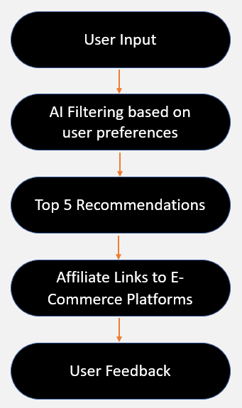
Lean Canvas
PROBLEM
Tech-savvy people, busy professionals, and online shoppers who feel confused by too many electronics options and lack knowledge about them.
EXISTING ALTERNATIVES
Amazon India
Flipkart
Reliance Digital
Tata Cliq
The names mentioned are just alternatives, but none truly offer the best experience.
SOLUTION
Curated, personalized top-5 product recommendations and Direct links for easy access.
UNIQUE VALUE PROPOSITION
Save time
Reduce complexity
Tailored shopping experience.
HIGH-LEVEL CONCEPT
PickDo makes choosing products easier by giving personalized recommendations based on users preferences like budget and features. Our platform helps customers quickly find the best options for their needs and provides direct links to buy, saving them time.
UNFAIR ADVANTAGE
AI based personalized filtering
Expert products knowledge.
Focused only on Electronics.
CUSTOMER SEGMENTS
Tech-savvy individuals
Busy professionals
Online shoppers
People with no idea on electronics.
EARLY ADOPTERS
Influencers
Tech Savvy's
Feedback providers
Business Model
KEY METRICS
Customer
engagement
Conversion rates
Affiliate link clicks
CHANNELS
Own Website
Through partnered e-commerce sites
Ads on Social Media
COST STRUCTURE
Platform development
Affiliate management
Marketing.
REVENUE STREAMS
Affiliate marketing commissions
Brand partnerships
Ads.

Slide 11
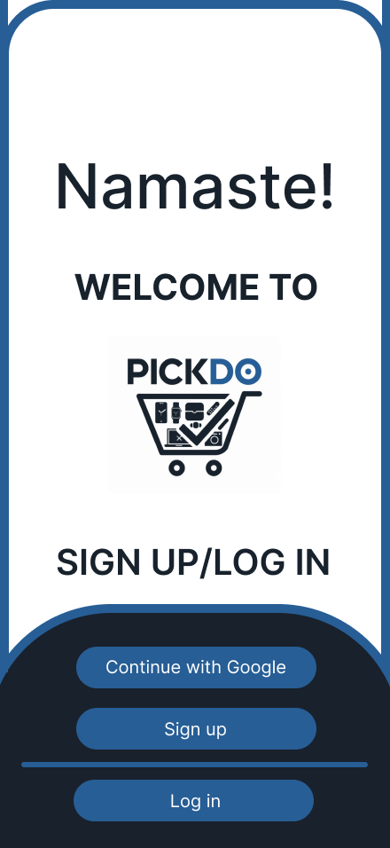
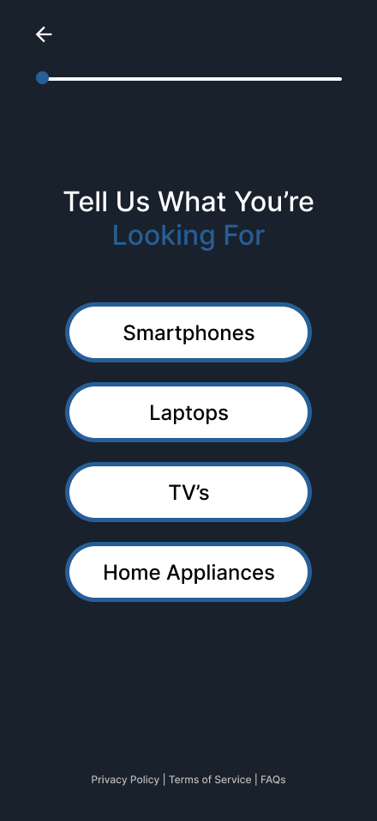
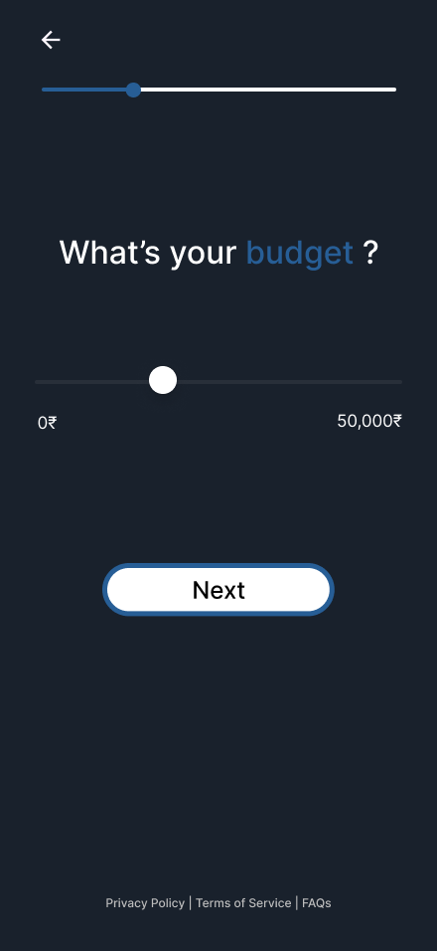
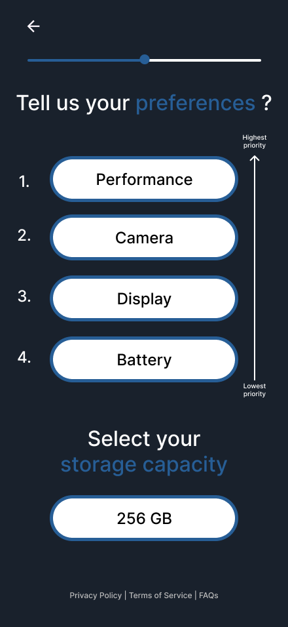
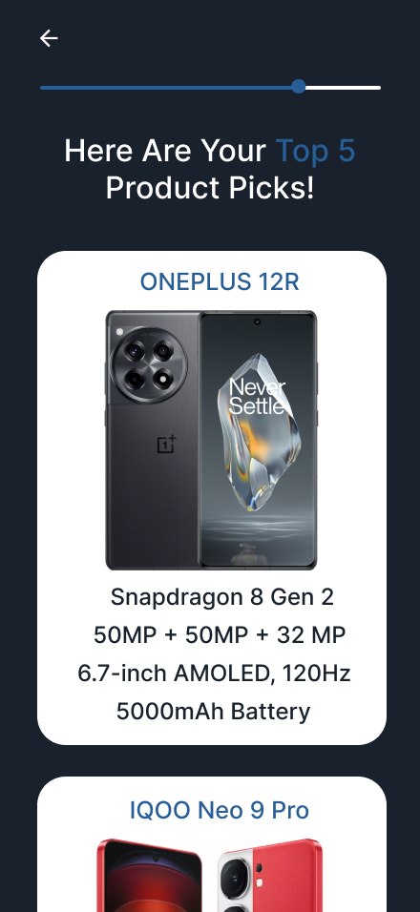
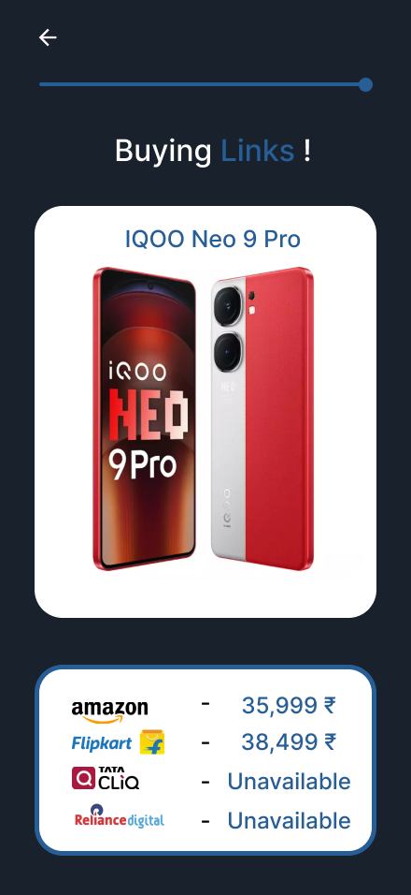

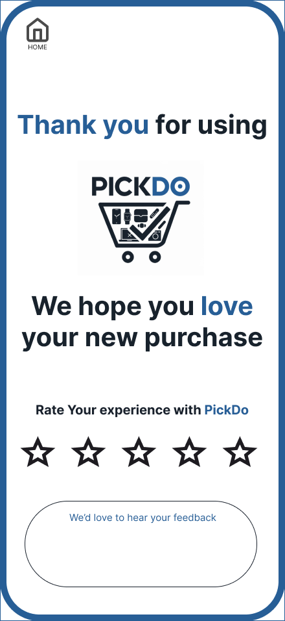
MVP
Link to Access the design:
https://www.figma.com/design/T6lbC4KxUKQxkEpQcNzZCg/PickDo?node-id=0-1&t=G4VFuZQIBi2EUsUf-1

Slide 12
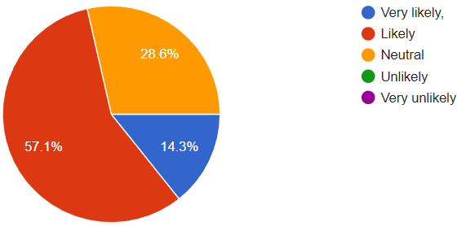
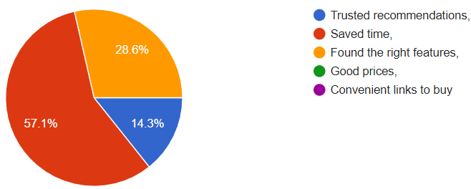
MVP Validation
What is your MVP : Our MVP is a platform that recommends the top 5 products based on what users want, making shopping quicker and easier.
Conclusion:
Test Details:
How long will we test this MVP : We plan to test the MVP for 2 weeks to gather enough user feedback, refine recommendations, and assess interest in repeated use.
Who is our target audience for the test? How many of them : Our target audience for testing includes tech-savvy young adults aged 20-35.
How will we get to that audience : Through tech forums, social media, and email invites for early access.
The MVP achieved its objective of offering valuable, time-saving recommendations. The initial testing confirmed customer interest, validating our affiliate-based model as a feasible revenue source.
Results of Test:
Realizations / Insights:
Did enough customers buy? Why or why not ?
About 60% clicked affiliate links, showing interest. Some were cautious to buy because they wanted more details about products.
Did customers pay the price we expected? Why or why not ?
Yes, most found the prices fair, though some were unsure about higher-priced items without more info.
Did customers come back to our product or show interest in doing so? Why or why not?
71.4% said they’d use it again, as it saved them time and reduced shopping hassle.
Did customers recommend our product to others or evangelize about it? Why or why not?
Some shared it with friends and said they’d recommend it more if it had extra filters and a mobile app.
Users are interested in additional filtering options and a mobile-optimized experience. These features would increase the likelihood of recommendations and referrals.
Next Steps:
Add more filters, improve mobile compatibility, and introduce a Compare feature to make choosing products easier. Expand testing to a larger audience for broader feedback and to fine-tune the algorithm.
Notes:
Evaluation Criteria for slides 12 to 14
Check the following on MVP? 1. Does it look credible and showable? Add a picture/video of the MVP? (3 marks) 2. Have you validated the product benefits and the price with real customers? Add the MVP interview records in a Google drive and add to the PPT. (1 + 1 marks)

Slide 13
Sales Plan
Customer Sales Funnel
Customer Acquisition Plan
TARGET MARKET:
LEADS:
Young, tech-savvy shoppers seeking convenient, personalized product recommendations.
Total Target Customer : 57,000 customers
1 | 2 | 3 | 4 | 5
Target Customer Segment (Type) | Target Customer Segment (Number) | Channels to be used to attract the target customer segment | Estimated number of leads | Estimated cost to convert these leads to actual customers
Tech-savvy individuals | 10,000 | Social media ads (Instagram, Twitter), influencer partnerships, tech-focused content on YouTube | 2,500 | $2,000
Busy professionals | 15,000 | LinkedIn ads, productivity blogs, targeted email marketing campaigns | 3,500 | $3,000
Online shoppers | 20,000 | Facebook ads, Google ads, e-commerce partnerships, seasonal discount campaigns | 5,000 | $4,000
People with no idea on electronics. | 12,000 | Beginner-friendly tutorials on YouTube, educational content on blogs, targeted ads | 3,000 | $2,500
Social media users and online shoppers interested in product reviews. 14,000 leads
OPPORTUNITIES/PROSPECTS:
A portion of leads who show higher interest or intent. Assume a conversion rate of 30% from leads to prospects: 4,200 prospects (30% of 14,000).
CUSTOMER:
A portion of prospects converted to paying customers. Assume 50% of prospects convert to customers: 2,100 customers (50% of 4,200).
Notes:
Evaluation Criteria for slide 20 to 22
1. Does the venture have a Sales projections sheet with monthly sales targets and customer funnel defined for the next one year? (2 marks) 2. Does the venture have an active social media presence, such as FB, Instagram, LinkedIn? (1 mark) 3. Do you have a well-thought out brand name, logo, and a Positioning statement? (1 mark) 4. Have you made an actual sale? (1 mark)

Slide 14
Go-to-Market Strategy
1. Social Media Strategy
Goal : Drive brand awareness, engage potential users, and demonstrate PickDo’s unique value in simplifying online shopping.
Content :
Feature Tutorials : Short, engaging tutorials that guide users on maximizing PickDo’s personalized recommendations and time-saving features.
Top Product Highlights : Regularly showcase trending and highly recommended products tailored to users’ interests.
User Success Stories : Share authentic testimonials and success stories to build credibility and illustrate the ease and effectiveness of PickDo.
Platforms : Focus on Instagram, Facebook, and YouTube, using a mix of short videos, visually appealing infographics, and interactive posts to reach and engage a tech-savvy audience.
2. Positioning Statement
PickDo transforms the shopping experience by offering personalized, time-saving product recommendations, empowering users to make confident decisions effortlessly

Slide 15
Go-to-Market Strategy
3. Action Plan
Objectives :
User Growth : Target 20% annual increase in the user base.
Conversion : Steadily improve affiliate link conversion rates.
Key Steps :
Monthly Campaigns : Feature trending or seasonal products.
New User Incentives : Offer early access to recommendations and exclusive discounts.
Quarterly Updates : Introduce new personalization features to enhance user experience.
4. Sales & Distribution Model
Primary Channel : Website, with future app potential.
Affiliate Model : Embed affiliate links within recommendations for seamless purchasing and revenue generation.

Slide 16
FINANCIAL PLAN
Start-up costs
Category | Estimated Cost (USD) | Description
Website Development | $5,000 | Building and customizing the website with product recommendation algorithms, search features, etc.
Mobile App Development | $4,000 | Optional but beneficial for reaching mobile users if you decide to create a dedicated app.
Content Creation | $1,500 | High-quality product images, tutorials, and descriptions for the initial product listings.
Branding and Design | $1,000 | Logo design, brand assets, and UI/UX design for a professional and appealing look.
Legal & Registration Fees | $800 | Business registration, trademark, and legal consulting fees.
Affiliate Partnerships | $500 | Initial costs to set up affiliate accounts and integrations with platforms like Amazon.
Marketing and Advertising | $2,000 | Initial social media ads, Google ads, and influencer partnerships to attract early users.
Hosting & Domain Costs | $300 | Hosting for the website, domain purchase, and SSL certificates.
Miscellaneous | $900 | Any unexpected costs during the initial setup phase.
Total Set-Up Costs | $16,000
Notes:
Evaluation Criteria for slide 24
1. Have you done their Unit Economics and come up with CAC, CLV, ARPU, Net and Gross Profit? (1 mark) 2. Do you have a plan on how to reduce their CAC and churn rate, and increase their CLV, ARPU, and Net Profit Margin? (2 marks) 3. Is the capital asked for as per the Funding plan in line with the business? (1 mark) 4. How long will it take you to return the investment? (1 mark)

Slide 17
FINANCIAL PLAN
Ongoing Operational Costs (Monthly)
Category | Estimated Monthly Cost (USD) | Description
Website & App Maintenance | $1500 | Monthly updates, bug fixes, and server maintenance.
Content Creation & Updates | $300 | Ongoing costs for adding new products, creating content, and keeping listings up-to-date.
Marketing & Advertising | $1,500 | Ongoing digital marketing efforts to reach new users and retain existing ones.
Affiliate Management Tools | $200 | Software to manage affiliate links, track conversions, and monitor earnings.
Customer Support | $500 | Customer service expenses, especially if using virtual assistants or chat support.
Hosting and Cloud Services | $200 | Server hosting, cloud storage for product images, and other technical services.
Total Monthly Operational Cost | $4,200
Notes:
Evaluation Criteria for slide 24
1. Have you done their Unit Economics and come up with CAC, CLV, ARPU, Net and Gross Profit? (1 mark) 2. Do you have a plan on how to reduce their CAC and churn rate, and increase their CLV, ARPU, and Net Profit Margin? (2 marks) 3. Is the capital asked for as per the Funding plan in line with the business? (1 mark) 4. How long will it take you to return the investment? (1 mark)

Slide 18
FINANCIAL PLAN
Revenue Projections
Year 1: $42,000
Year 2: $100,800
Year 3: $201,600
Year 4: $345,600
Year 5: $540,000
Break-Even Analysis
Estimated Break-Even Time: 10-12 months
Explanation:
This financial plan outlines the estimated costs and revenue for our e-commerce affiliate and recommendation platform, PickDo. The start-up costs represent the initial investment required to launch the business, while the ongoing operational costs are the recurring expenses needed to keep it running. The revenue projections provide a forecast of potential earnings over the next three years, and the break-even analysis estimates the time it will take to recover the initial investment.
Link of Financial Plan: PickDo Financial Plan.docx
Notes:
Evaluation Criteria for slide 24
1. Have you done their Unit Economics and come up with CAC, CLV, ARPU, Net and Gross Profit? (1 mark) 2. Do you have a plan on how to reduce their CAC and churn rate, and increase their CLV, ARPU, and Net Profit Margin? (2 marks) 3. Is the capital asked for as per the Funding plan in line with the business? (1 mark) 4. How long will it take you to return the investment? (1 mark)

Slide 19
Forecast P&L
setup costs and projected monthly operating costs:
1. Sales
Monthly Revenue (Year 1): Estimated at $3,500 based on the projections.
Annual Revenue (Year 1): $42,000.
MONTH | JAN | FEB | MARCH | APRIL | MAY | JUNE | JULY | AUG | SEPT | OCT | NOV | DEC | TOTAL
REVENUE | $3,500 | $3,500 | $3,500 | $3,500 | $3,500 | $3,500 | $3,500 | $3,500 | $3,500 | $3,500 | $3,500 | $3,500 | $42,000
2. COGS (Cost of Goods Sold)
This is minimal or $0 as PickDo is a recommendation platform and doesn’t handle physical inventory.
MONTH | JAN | FEB | MARCH | APRIL | MAY | JUNE | JULY | AUG | SEPT | OCT | NOV | DEC | TOTAL
REVENUE | $3,500 | $3,500 | $3,500 | $3,500 | $3,500 | $3,500 | $3,500 | $3,500 | $3,500 | $3,500 | $3,500 | $3,500 | $42,000
COGS | $0 | $0 | $0 | $0 | $0 | $0 | $0 | $0 | $0 | $0 | $0 | $0 | $0
Notes:
Evaluation Criteria for slide 24
1. Have you done their Unit Economics and come up with CAC, CLV, ARPU, Net and Gross Profit? (1 mark) 2. Do you have a plan on how to reduce their CAC and churn rate, and increase their CLV, ARPU, and Net Profit Margin? (2 marks) 3. Is the capital asked for as per the Funding plan in line with the business? (1 mark) 4. How long will it take you to return the investment? (1 mark)

Slide 20
Forecast P&L
setup costs and projected monthly operating costs:
3. Operating Expenses
Based on the provided setup, we’ll allocate the estimated $4,200 monthly operating expenses.
Category | Monthly Cost
Salaries and Consultant Fees | $1,500
Marketing and Promotion | $1,500
Utilities | $300
Transportation (if any) | $0
Office Supplies | $200
Customer Support | $500
Hosting & Cloud Services | $200
Total Monthly Expenses | $4,200
MONTH | JAN | FEB | MARCH | APRIL | MAY | JUNE | JULY | AUG | SEPT | OCT | NOV | DEC | TOTAL
TOTAL EXPENSES | $4,200 | $4,200 | $4,200 | $4,200 | $4,200 | $4,200 | $4,200 | $4,200 | $4,200 | $4,200 | $4,200 | $4,200 | $50,400
4. Result (Net Profit/Loss)
Gross Profit: $42,000
Total Expenses: $50,400
Net Profit/Loss: -$8,400 (Year 1, Loss)
Notes:
Evaluation Criteria for slide 24
1. Have you done their Unit Economics and come up with CAC, CLV, ARPU, Net and Gross Profit? (1 mark) 2. Do you have a plan on how to reduce their CAC and churn rate, and increase their CLV, ARPU, and Net Profit Margin? (2 marks) 3. Is the capital asked for as per the Funding plan in line with the business? (1 mark) 4. How long will it take you to return the investment? (1 mark)

Slide 21
Forecast P&L
Total Revenue (Year 1): $42,000
Total Expenses (Year 1): $50,400
Net Loss (Year 1): -$8,400
Explanation:
PickDo expects to generate $42,000 in revenue in its first year through affiliate commissions.
The platform will incur $50,400 in operating expenses, leading to a net loss of $8,400 in the initial year as it establishes its user base.
Projected Break-Even: With growth in users and revenue, PickDo is expected to move towards profitability by the end of the second year.
Link of Forecast P&L: PickDo Forecast P^0L.docx
Notes:
Evaluation Criteria for slide 24
1. Have you done their Unit Economics and come up with CAC, CLV, ARPU, Net and Gross Profit? (1 mark) 2. Do you have a plan on how to reduce their CAC and churn rate, and increase their CLV, ARPU, and Net Profit Margin? (2 marks) 3. Is the capital asked for as per the Funding plan in line with the business? (1 mark) 4. How long will it take you to return the investment? (1 mark)

Slide 22
Financial Projections
 | Year 1 | Year 2 | Year 3 | Year 4 | Year 5
Number of sales | 2,100 | 4,200 | 8,064 | 12,800 | 18,000
Values of each sale(Contribution) | $20 | $24 | $25 | $27 | $30
Total revenue | $42,000 | $100,800 | $201,600 | $345,600 | $540,000
Capital costs
Land and buildings | $0 | $0 | $0 | $0 | $0
Equipment | $0 | $0 | $0 | $0 | $0
Product Development costs | $0 | $0 | $0 | $0 | $0
Others | $0 | $0 | $0 | $0 | $0
Total | $0 | $0 | $0 | $0 | $0
Expenses(Annual)
Salaries | $18,000 | $24,000 | $30,000 | $33,600 | $36,000
Marketing and promotion | $18,000 | $22,800 | $26,400 | $30,000 | $34,800
Utilities(Electricity etc..) | $3600 | $6000 | $8,400 | $10,800 | $14,400
Transportation(Shipping, Courier, Taxies etc..) | $0 | $0 | $0 | $0 | $0
Office supplies | $2400 | $4,800 | $7,200 | $10,800 | $13,200
Repairs and Maintenance | $6000 | $7,200 | $10,800 | $15,600 | $18,000
Misc. Expenses | $2,400 | $3,000 | $6,000 | $8,400 | $12,000
Total | $50,400 | $67,800 | $88,800 | $109,200 | $128,400
Total | $50,400 | $67,800 | $88,800 | $109,200 | $128,400
Earnings(EBDITA) | -$8,400 | $33,000 | $112,800 | $236,800 | $411,600
Number of existing shares | 1,000,000
Amount to be invested | $50,000
Earnings after 5 years | $411,600
P/E ratio | 20
Discount rates | 10%
Number of years | 5
Estimated terminal value | $8,232,000
Present value | $5,110,000
Required ownership percentage | 0.98%
Number of shares needed by investors | 9,800
Shared price | $5.11
Notes:
Evaluation Criteria for slide 24
1. Have you done their Unit Economics and come up with CAC, CLV, ARPU, Net and Gross Profit? (1 mark) 2. Do you have a plan on how to reduce their CAC and churn rate, and increase their CLV, ARPU, and Net Profit Margin? (2 marks) 3. Is the capital asked for as per the Funding plan in line with the business? (1 mark) 4. How long will it take you to return the investment? (1 mark)

Slide 23
Unit Economics
P & L/ unit | Year 1
Revenue | $42,000
COGS | $0
Gross Profit | $42,000
Gross Profit Margin | 100% (since no COGS)
Operating Costs | $50,400
Operating Profit | -$8,400
Unit Economics | Year 1
CAC | $100
CLV | $500
ARPU | $20
Assumptions (Year 1)
Metric | Formula | Calculation | Result
Gross Profit | Revenue – COGS | $42,000 - $0 | $42,000
Gross Profit Margin | (Revenue/Gross Profit​) × 100% | (42,000/42,000)​×100% | 100%
Operating Costs | Cost of goods sold (COGS) + operating expenses (OPEX) | $0 + $50,400 | $50,400
Operating Profit | Gross Profit - Operating Costs | $42,000 - $50,400 | -$8,400
Operating Profit Margin | (Operating Profit/Revenue) × 100% | (-8,400/42,000)​×100% | -20%
CAC | (Cost of Sales + Cost of Marketing ) / Number of new customers acquired (in currency terms)​ | - | $100
CLV | Average purchase value x Average purchase frequency x Average Customer Lifespan x Gross Margin | - | $500
ARPU | Total revenue in specific period/Total number of customers during the same period (in currency terms)​ | - | $20
Term | Explanation | Value
CAC | Cost to Acquire a Customer | $100
CLV | Customer Lifetime Value | $500
ARPU | Average Revenue Per User | $20
Gross Profit Margin | % of revenue remaining after COGS | 100%
Operating Profit Margin | % of revenue remaining after all expenses | - 20%

Slide 24
Funding Plan
How much funds required to reach to the next level of the venture?
Estimate: Based on the financial plan and setup costs provided, PickDo requires $16,000 to cover initial setup costs and $3,500 per month for operational costs. To sustain for one year, an additional $50,400 is needed. Therefore, the total funding required to reach the next level (operational for one year) is approximately $66,400.
How much have been bootstrapped? If not, why ?
$5,000.
How much can be bootstrapped?
$5,000 to $10,000
How much external funding required? If not, why?
$40,800 to $45,800
External funding is necessary to:
Cover the remaining operational and setup costs.
Execute a robust marketing strategy to scale.
Add essential features like advanced filtering and mobile
compatibility, as suggested by the MVP test feedback.
Funds utilization strategy (Details)
Platform Development: $5,000.
Mobile App Development: $4,000.
Marketing and Advertising: $2,000.
Content Creation: $1,500.
Operational Costs (Hosting, Support, etc.): $2,600 (for one year).
Miscellaneous Expenses: $900.
Notes:
Evaluation Criteria for slide 19
1. Have you identified how much fund you need to reach the next level for the venture? (1 mark) 2. Have you bootsrapped any money till now? How much can they bootstrap?(1 mark) 3. Do you need external funding? Why or why not? (1 mark) 4. Can you explain clearly how you will utilize the money tomorrow if they get the funding today? (2 marks)

Slide 25


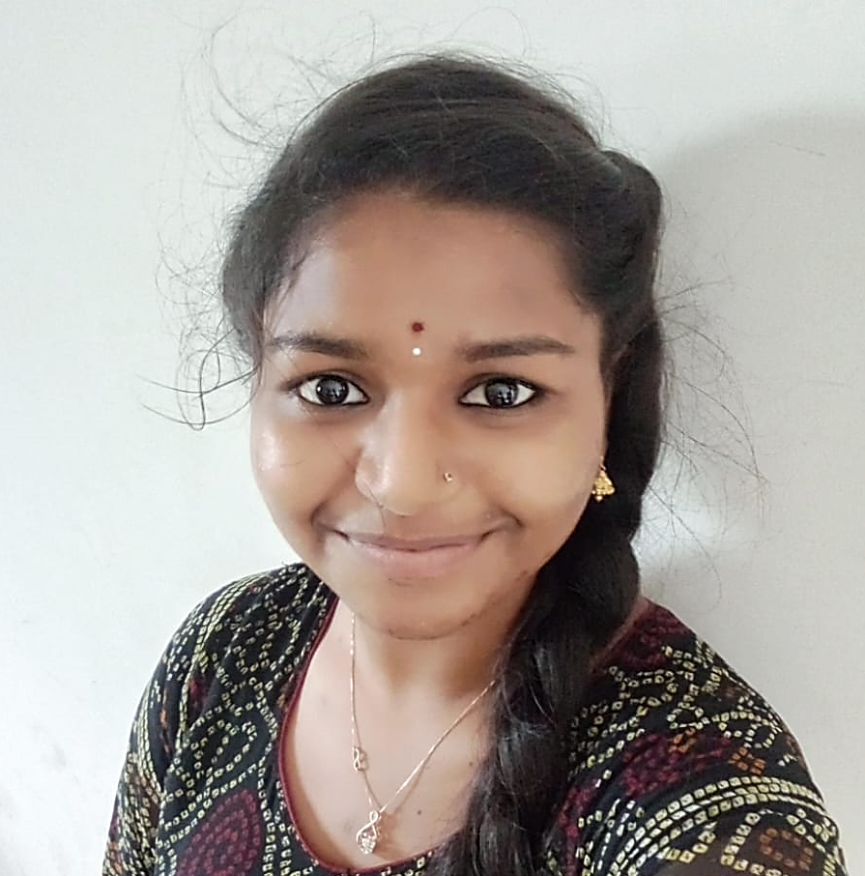
Team Composition
What makes us a good team to solve the problem we chose?
----------------------------------------------------------------------
We’re a strong team for solving our chosen problem because we each bring unique strengths. Our leader keeps us focused, while another ensures smooth operations. We leverage the latest technology and combine creative marketing with financial insight. Together, we communicate openly and work well as a team, making it easy to tackle challenges and find effective solutions.
Jayadithya
Tanmai Kiran
Sai Lakshmi Tejaswini
CEO
COO
CFO
Great at seeing the big picture and making smart decisions to guide the team forward. Knows how to motivate the team and communicate clearly with everyone involved. Always thinking about the future and how to take us there.
Skilled at keeping daily operations running smoothly while also leading the tech side of things. Great at problem-solving and making sure both our processes and technology are efficient and up-to-date.
Creative and strategic, with a strong ability to grow our brand while also managing the financial side. Focused on building effective marketing campaigns and keeping our finances on track to ensure sustainable growth.

Slide 26
THANKYOU

